Slide 1

CHROME EXTENSIONS
HELLO
COMPUTER

Slide 2

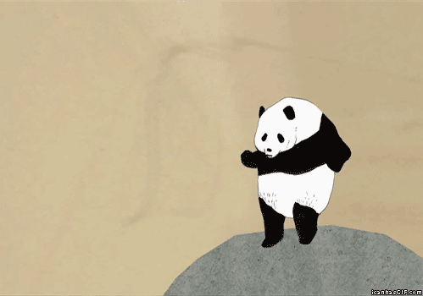
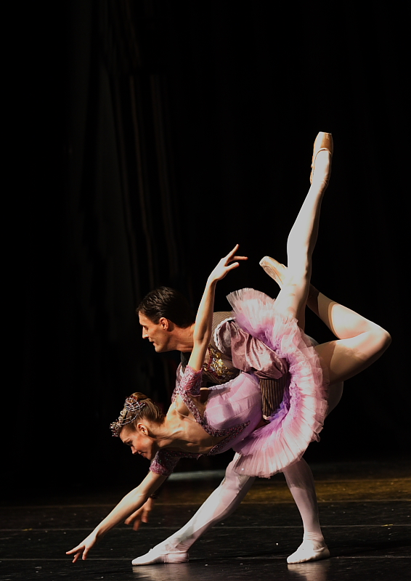
BACKGROUND
Data Engineering
Antoinette Biagi (Tony)
Assurance Innovation & Technology
Data Engineering
Georgia Tech c/o 2012
6 Years at PwC

Slide 3
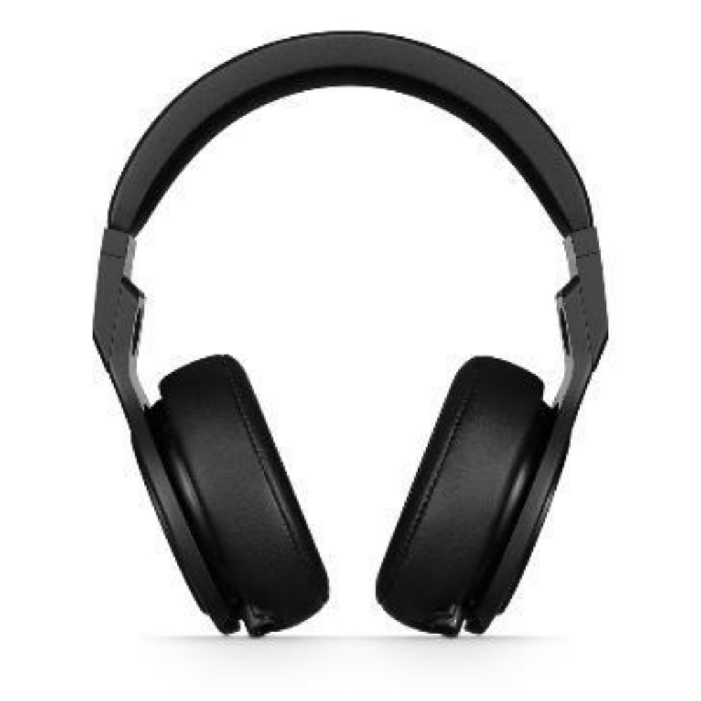
TIME IS THE GREAT EQUALIZER
A FEW WORDS ABOUT WORK
We all have 24 hours and 7 days per week.
Exclude 56 hours for sleep and we’re left with 112 hours to achieve all we intend to accomplish. You can’t manage time, only choose what to do with it.
If you find yourself performing a repetitive task, odds are there is a better way. Automate the boring stuff.
Don’t accept defaults. Customize your environment.
When one door closes, smash open a window.
MAKE IT WORK
FOR YOUR NEEDS

Slide 4
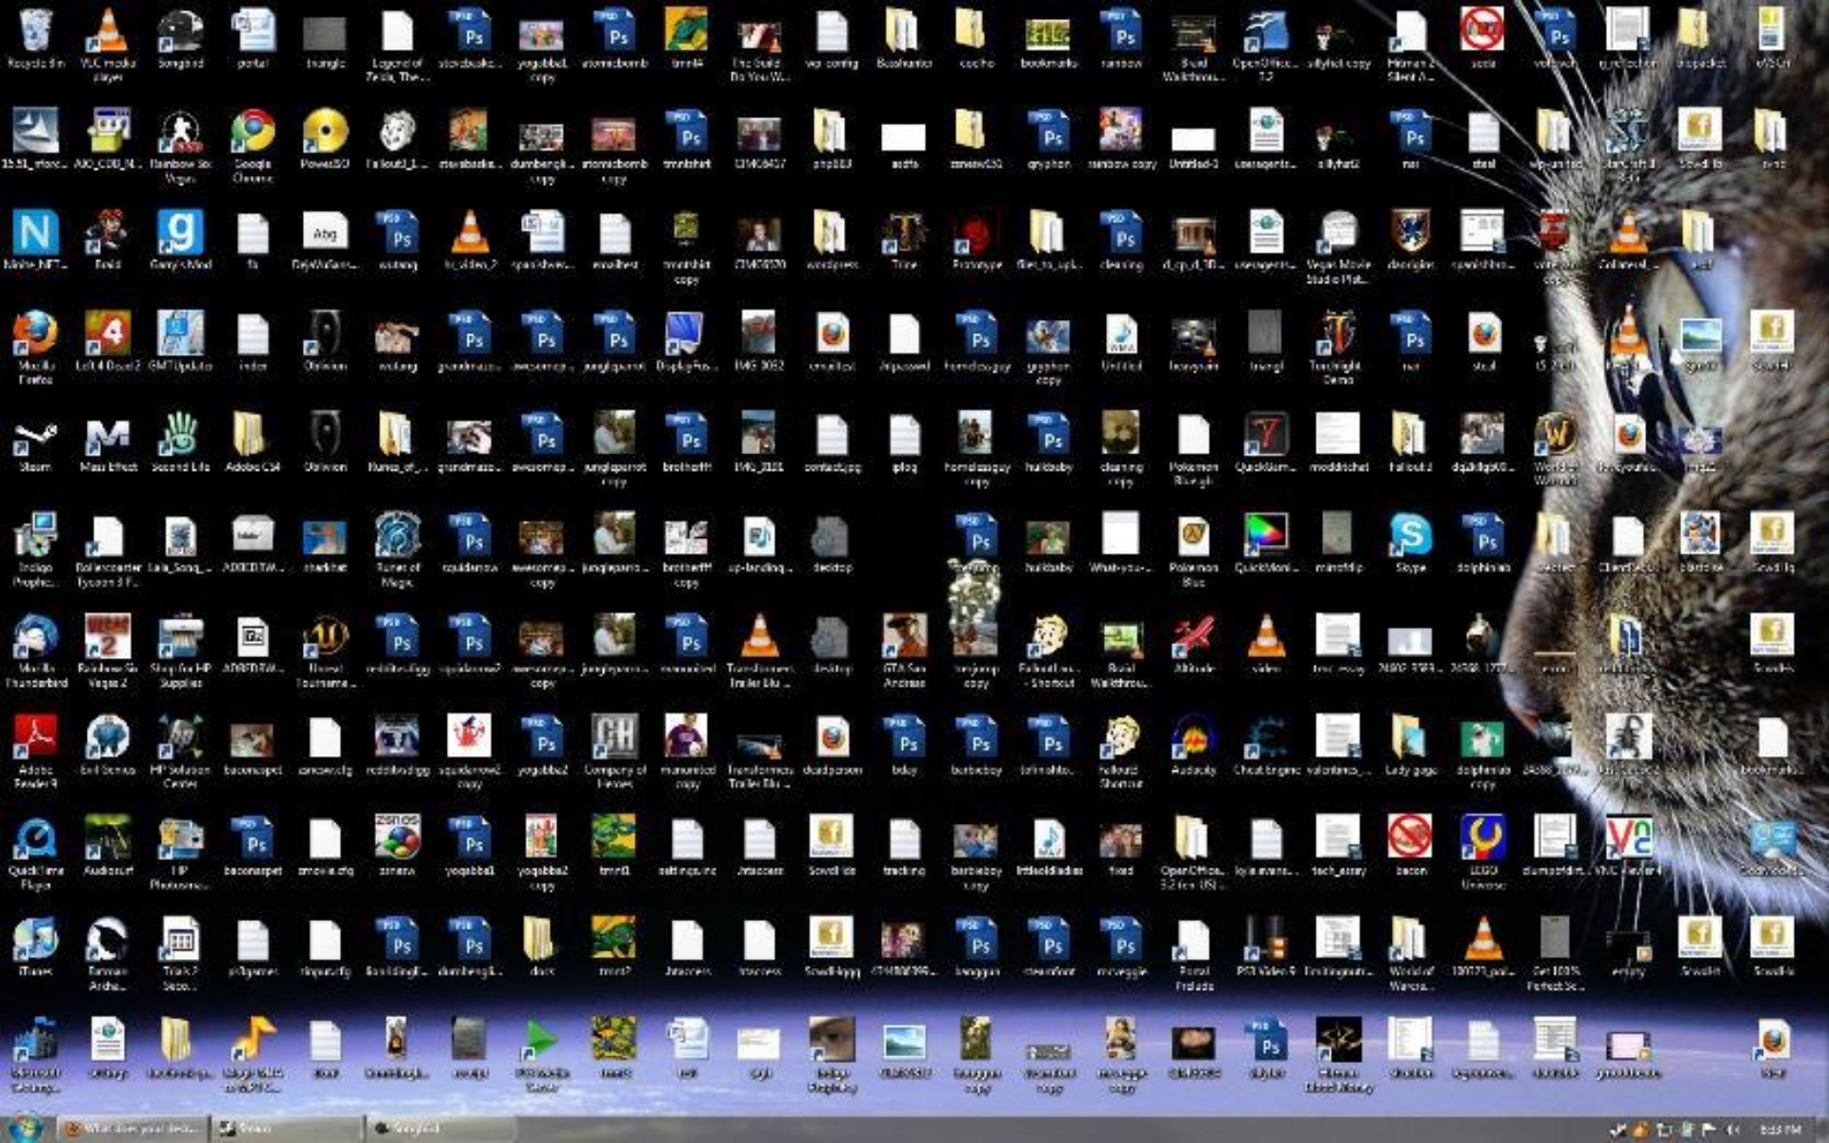
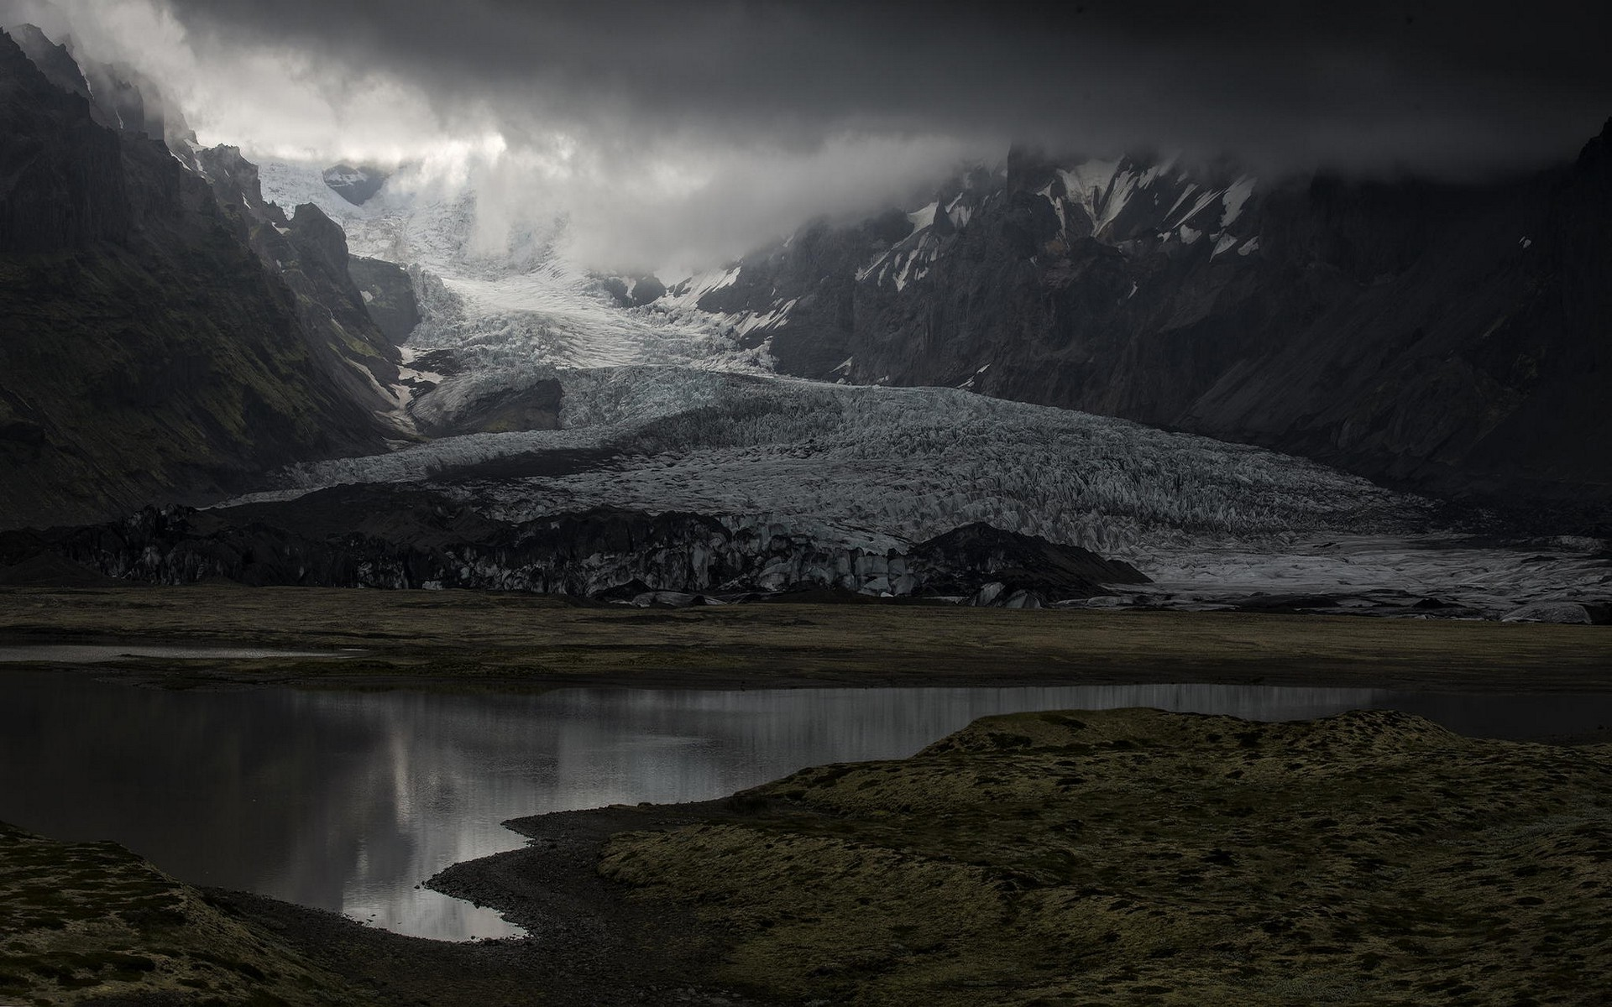
YOUR LAPTOP IS YOUR CANVAS
CLEAR YOUR MIND
In 2020, your attention span will be threatened. You will be inundated with icons, notifications, sounds, dialogue boxes, flashing chat windows and ever-growing unread badge icons.

Slide 5

Today’s
Focus

Slide 6



CODE EDITING REDEFINED
VISUAL STUDIO CODE
A lightweight but powerful source code editor which runs on your desktop.
Some of the best Monthly Release Notes I have ever seen.
MEET INTELLISENSE
Go beyond syntax highlighting and autocomplete with IntelliSense, which provides smart completions based on variable types, function definitions, and imported modules.
GIT COMMANDS BUILT-IN
Review diffs, stage files, and make commits right from the editor.
Push and pull from any hosted Git service.
EXTENSIBLE AND CUSTOMIZABLE
Install extensions for themes, debuggers, and additional services.
Extensions run in separate processes, ensuring they won’t slow down your editor.
Notes:
We are not changing your day to day development. Continue to use VS if you like it. Otherwise we recommend VS Code. What we are changing is where you are working. You should be developing from your local machine.
Use the terminal server when you need a larger in memory foot print.

Slide 7


NOT FOR EVERYBODY – JUST YOU
VIVALDI
Built on modern web technologies: JavaScript and React
FASTER NAVIGATION
Utilize Chrome extensions to customize the experience.
View any site in your Vivaldi side panel.
TAB MANAGEMENT
Open tabs can be saved as a session.
Easy tab cycling, tab stacks, tiling and visual previews.
VISUAL
Vivaldi has an adaptive interface that adjusts to the color of the page you’re viewing.

Slide 8


SCREEN CAPTURE FOR VISUAL DOCUMENTATION
SNAG-IT
Create images and videos to clearly get your point across. Spend less time trying to explain things and more time on the work that matters.
CAPTURE EVERYTHING
Take a screenshot or record a video of what you see on your computer screen.
ENHANCE SCREENSHOTS
Customize and edit every screenshot with markup tools. Trim images and recordings or convert videos into animated GIFs.
LIBRARY OF PRIOR CONTENT
Access every screenshot ever captured in a common library. Easily navigate by timestamp, application, or file type.

Slide 9
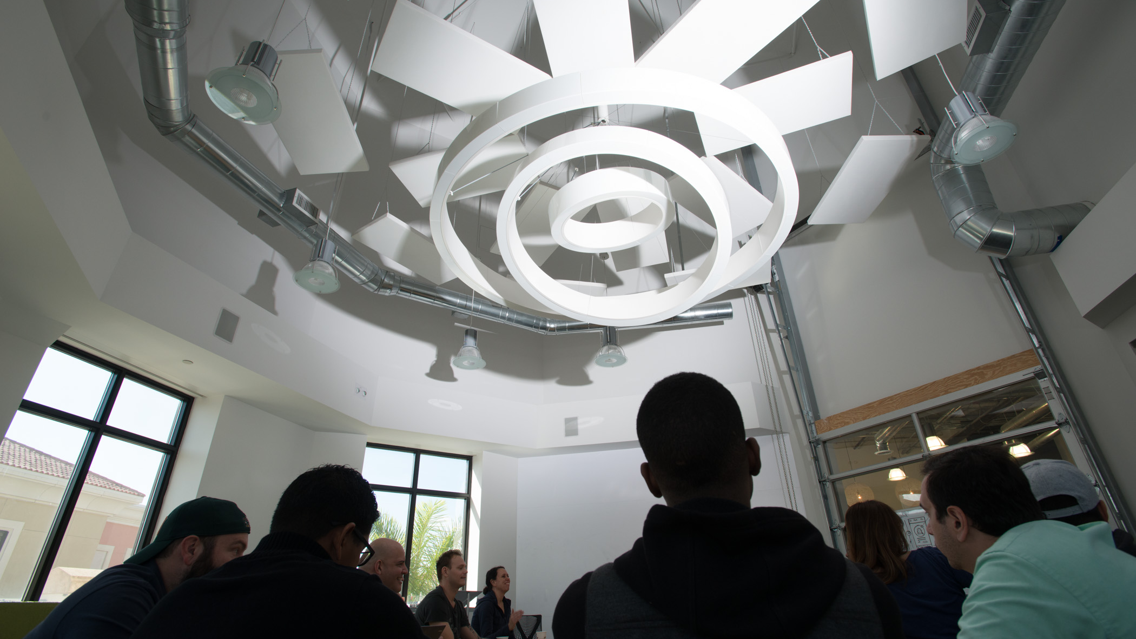

CHROME
ESSENTIALS

Slide 10

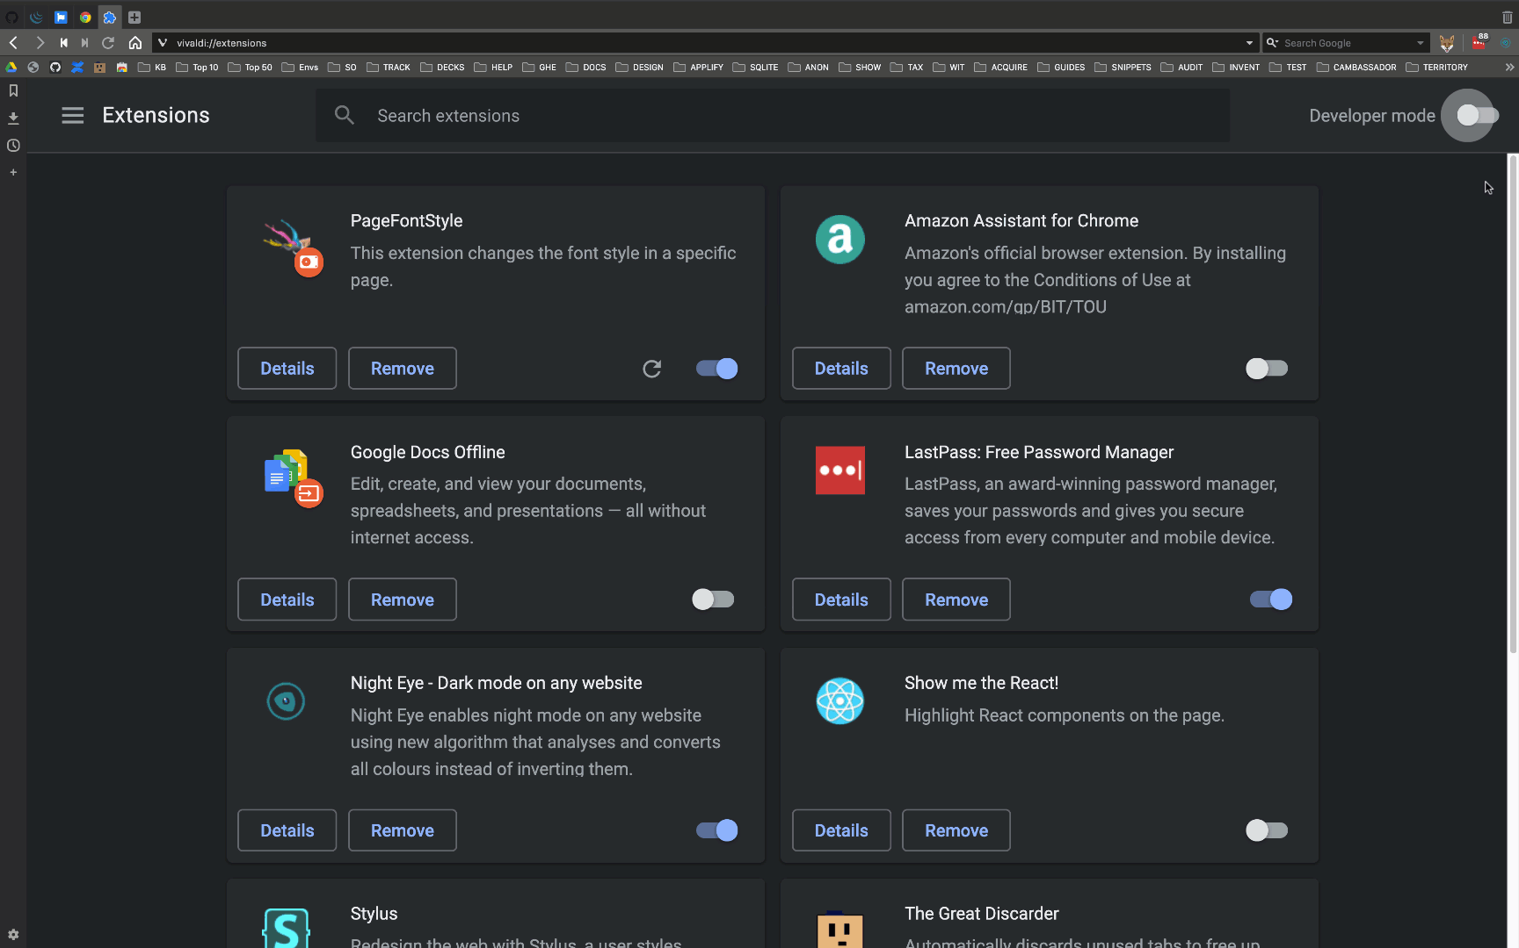
MAKE YOUR BROWSER WORK FOR YOU
CHROME EXTENSION BUNDLE
AUTOMATE YOUR MOST FREQUENT OPERATIONS
MANIFEST
All the metadata about your extension
HTML / CSS / JAVASCRIPT
Highly customizable, beautiful UI options, configure to suit your use case
ICONS
Brandify your extension with imagery unique to your message

Slide 11

SOURCE CONTROL
GIT
https://github.com/NotoriousBiagi/baby-chrome-extension

Slide 12
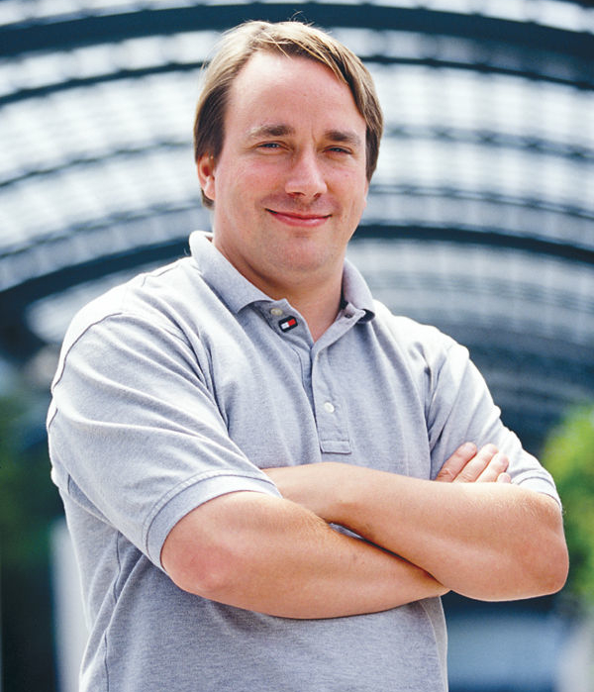
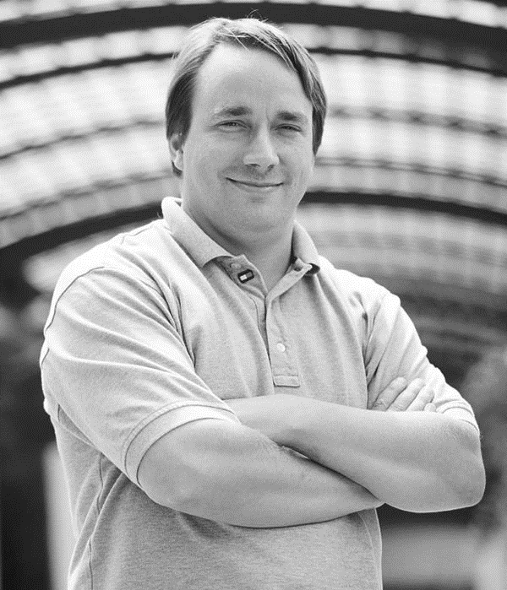


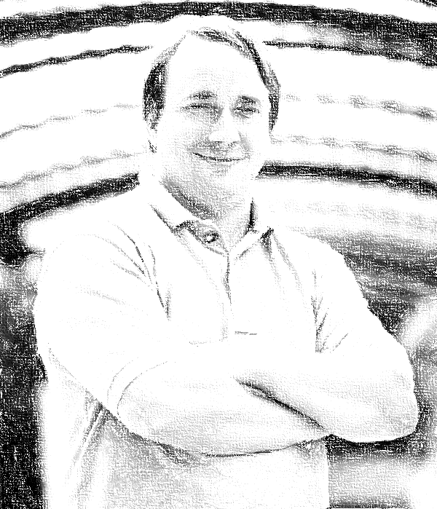
CONCURRENT DEVELOPMENT
GITTING THERE
Version control for tracking changes in files and coordinating work among multiple developers. Every git directory is a full-fledged repository with complete history and full version tracking abilities.
Linus_Noir
Linus_Noir Added
Linus_Noir Official
Linus’s Evil Twin
Linus
Linus_RGB
Linus_Abstract
PULL REQUEST
ADD| COMMIT | PUSH
Make your changes super official by merging them into a production branch. Halo for ERP expects your updates to ship pylint-compliant with unit tests included.
BRANCHING
Add your updates git add, commit your updates, git commit –m “Commit Message”, and git push to submit changes to a remote repository.
CLONE
Develop features isolated from each other. New features will be merged to a master branch.
Create a working copy of a local repository by running git clone.

Slide 13


COMMAND LINE OR GUI INTERFACE
GIT PARADIGMS
You have options. Manage files via git through a command-line interface or within Visual Studio.

Slide 14



TRY ME
FEATURED APPLICATIONS
Assemble a suite of applications to address your biggest frustrations.
Visual Studio Code
Light-weight source code editor
Vivaldi
A million ways to customize your browser
Snag-It
Capture your screen and communicate better
RoyalTS
Comprehensive Remote Management Solution
TreeSize
Disk space management software
F.lux
Make your eyes happier

Slide 15

KEEP IT CLEAN
TREESIZE
Disk space management software at its best.
MANAGE DISK SPACE
Find out which folders are the largest on your drives and recover precious disk space. Find space hogs and quickly delete unnecessary files.
SEARCH FOR REDUNDANT FILES
Versatile file search helps you find old, big, temporary, and duplicate files on drives. Search results can be moved, deleted, or exported to a ZIP file.
VISUALIZE RESULTS
Graphical analyses provide a quick visualization of disk space usage. You can see folder sizes, allocated disk space, owner, and user permissions.

Slide 16

SCREENS LOOK LIKE THE SUN
F.LUX
Make the color of your computer’s display adapt to the time of day, warm at night and like the sunlight during the day. Eventually, you’ll get better sleep.
ADAPT TO THE ROOM YOU’RE IN
Once enabled, f.lux runs in the background and silently adjusts with the lighting sources and time of day.
REDUCES EYE STRAIN
Night-time exposure to blue light affects your circadian timing.

Slide 17
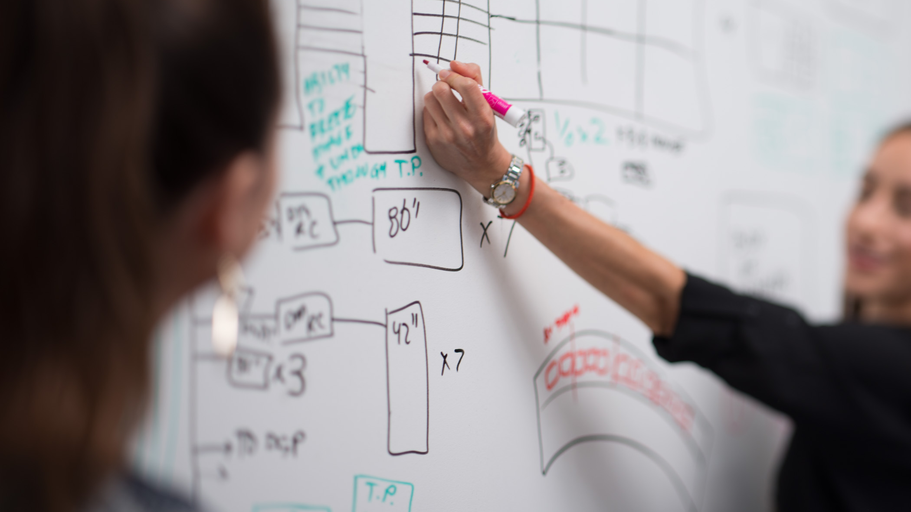
NEXT UP: GMAIL

Slide 18









REMOVE POTENTIAL DISTRACTIONS
STAY FOCUSED
Gmail defaults are not enough. Re-configure your mail client to stay focused on your real job.
UNSUBSCRIBE
EMAIL YOU DON’T CARE ABOUT
AUTO-LABEL
FREQUENT CATEGORIES
GOOGLE LABS
TRY OUT PROTOTYPES
APPLY FILTERS
REMOVE USELESS EMAILS
STAR IT UP
TO PRIORITIZE TASKS
GO ON MUTE
OPT OUT OF NEVER-ENDING EMAIL
CHAINS
AUTO-ARCHIVE
MAIL YOU NEED, BUT DON’T WANT
TO SEE
STASH NEW MAIL
ON ARRIVAL
SLICK THEME
ENJOY THE EXPERIENCE

Slide 19
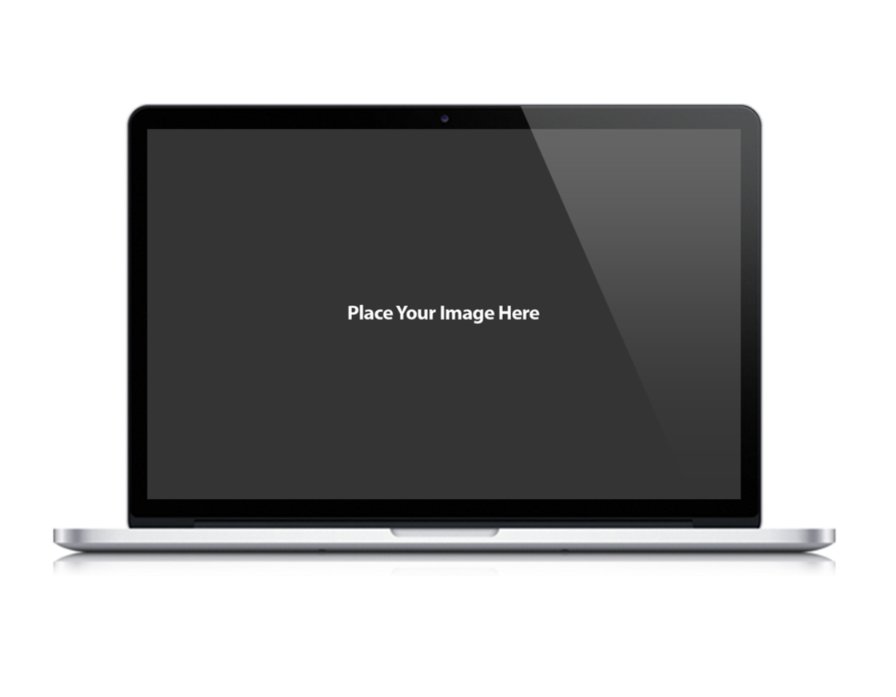

FILTER, ARCHIVE, LABEL, STAR, AND LIMIT DISTRACTION
GMAIL
Email is the cornerstone of personal and professional communications. Separating what’s important from fluff is a daunting task.

Slide 20






MAKE YOUR LIFE A BIT EASIER
HONORABLE MENTION
A few personal favorites to try out.
GIST BOX
ATOM
LAST-PASS
A-TRACKER
FENCES
GOO.GL

Slide 21




CTRL+CLICK EACH ICON TO VIEW EACH TOOL
RECOMMENDED DOWNLOADS
Links change over time – a general search for any of the keywords below should eventually navigate you to a proper downloads page or installation file. Google is our least expensive consultant. Use it well.

